Slide 1
SEQUENTIAL CIRCUITS - III
Design Method for synchronous counters

Slide 2
Design Method - Synchronous Counters
Goal : Given the state diagram of a counter realize it using common FFs (and combinational logic).
CBA
000
001
111
Example : Design a 3-bit counter having the following state diagram. Use D FFs.
C B
A
110
State Diagram
010
Functional block diagram of 3-bit counter.
101
011
100
3-bit synchronous counter
FF outputs are fed back to combinational circuit inputs.
Combinational circuit outputs D_{A}, D_{B}, & D_{C} are connected to D FF inputs and will be transferred to the output at next active clock edge.
Key: Design combinational circuit to take previous counter outputs & produce the next state.
Systematic design method is similar to that used for FF conversion considered before.
D Q
_
Q
C D_{C}
B D_{B}
A D_{A}
D Q
_
Q
Combinational circuit
CLK
D Q
_
Q

Slide 3
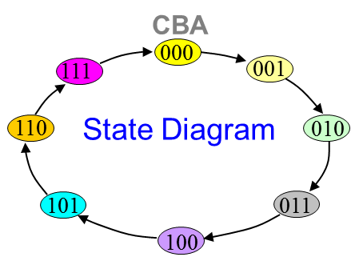
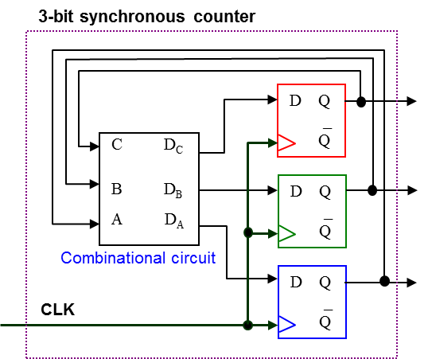
Design Method : Steps
Step 1
Draw a State Diagram for the desired Count Sequence
Step 2
Determine the Functional Block Diagram of the N-bit Counter.
1) Number of flip-flops?
2) Inputs and Outputs of combinational circuit?
C D_{C}
B D_{B}
A D_{A}
Combinational Circuit
Inputs: Present-state counter outputs (A,B,C).
Outputs: Next-state counter outputs to connect to FF inputs. (D_{A}, D_{B}, D_{C})

Slide 4
Design Method – Cont’d
Step 3A
Truth table of the combinational circuit. A. Determine next state table for the counter.
Present-state outputs
Next-state outputs
C | B | A | C⁺ | B⁺ | A⁺
0 | 0 | 0 | 0 | 0 | 1
0 | 0 | 1 | 0 | 1 | 0
0 | 1 | 0 | 0 | 1 | 1
0 | 1 | 1 | 1 | 0 | 0
1 | 0 | 0 | 1 | 0 | 1
1 | 0 | 1 | 1 | 1 | 0
1 | 1 | 0 | 1 | 1 | 1
1 | 1 | 1 | 0 | 0 | 0
C
B
A
Next-State Table
A synchronous counter can be realized with D FFs or with any other FF

Slide 5
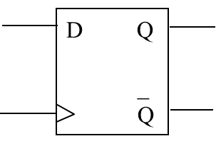
Design Method – Cont’d
*Excitation Table : Specifies what the FF inputs should be for a specific Q → Q⁺ transition to occur.
Step 3B
Truth table of the combinational circuit. B. Using the excitation table, determine the output values of the combinational circuit.
Next-state outputs
Required FF input
Present-state outputs
C | B | A | C⁺ | B⁺ | A⁺
0 | 0 | 0 | 0 | 0 | 1
0 | 0 | 1 | 0 | 1 | 0
0 | 1 | 0 | 0 | 1 | 1
0 | 1 | 1 | 1 | 0 | 0
1 | 0 | 0 | 1 | 0 | 1
1 | 0 | 1 | 1 | 1 | 0
1 | 1 | 0 | 1 | 1 | 1
1 | 1 | 1 | 0 | 0 | 0
D_{C} | D_{B} | D_{A}
0 | 0 | 1
0 | 1 | 0
0 | 1 | 1
1 | 0 | 0
1 | 0 | 1
1 | 1 | 0
1 | 1 | 1
0 | 0 | 0
D Flip Flop
Excitation Table
Q | Q⁺ | D
0 | 0 | 0
0 | 1 | 1
1 | 0 | 0
1 | 1 | 1
D ⬄ Q⁺
Next-State Table
We now have a truth table for the combinational circuit!
C D_{C}
B D_{B}
A D_{A}

Slide 6
Design Method – Cont’d
Step 4
Realize the circuit.
Present-state outputs
Required FF input
C | B | A
0 | 0 | 0
0 | 0 | 1
0 | 1 | 0
0 | 1 | 1
1 | 0 | 0
1 | 0 | 1
1 | 1 | 0
1 | 1 | 1
D_{C} | D_{B} | D_{A}
0 | 0 | 1
0 | 1 | 0
0 | 1 | 1
1 | 0 | 0
1 | 0 | 1
1 | 1 | 0
1 | 1 | 1
0 | 0 | 0

Slide 7
Design Example…

Slide 8
Synchronous Counter Example 2
Design a synchronous counter with count sequence using DFFs:
101,001,000,010,110,100,101,… (mod-6).
The counter also has an external active high synchronous CLEAR input which will clear the counter to 000 at next active clock edge when set to ‘1’.
e.g. 101,001,000,010,110,100,000,010..
CLEAR

Slide 9
1) State Diagram

Slide 10
2) Functional Block Diagram

Slide 11
3) Next State Table / Truth table of C.C.

Slide 12
4) Final Implementation

Slide 13
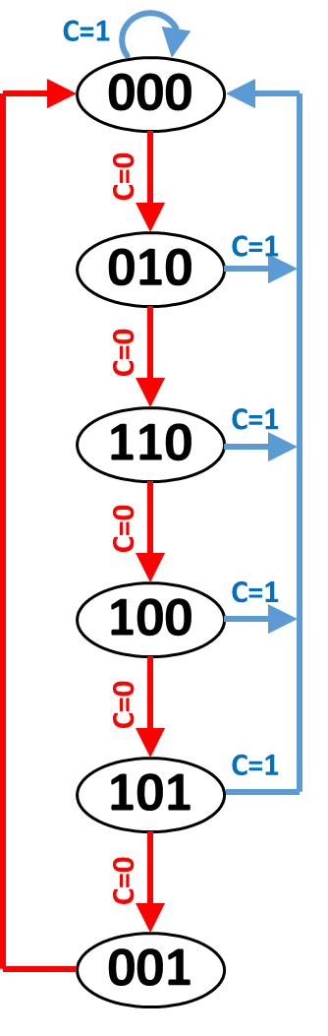
Step1: Write state diagram. | Step2: Determine functional block diagram of counter. | Step3 : Functional block diagram of combinational circuit.
C
B A
D Q _ Q
C D_{C}
B D_{B}
A D_{A}
CLEAR
C D_{C}
B D_{B}
A D_{A}
D Q _ Q
CLEAR
Combinational Circuit
CLK
D Q _ Q
Step4 : Get TT of combinational circuit using FF excitation table.
Step5 : Realize circuit.
CLEAR | C | B | A | C⁺ | B⁺ | A⁺ |  | D_{C} | D_{B} | D_{A}
0 | 0 | 0 | 0 | 0 | 1 | 0 |  | 0 | 1 | 0
0 | 0 | 0 | 1 | 0 | 0 | 0 |  | 0 | 0 | 0
0 | 0 | 1 | 0 | 1 | 1 | 0 |  | 1 | 1 | 0
0 | 0 | 1 | 1 | X | X | X |  | X | X | X
0 | 1 | 0 | 0 | 1 | 0 | 1 |  | 1 | 0 | 1
0 | 1 | 0 | 1 | 0 | 0 | 1 |  | 0 | 0 | 1
0 | 1 | 1 | 0 | 1 | 0 | 0 |  | 1 | 0 | 0
0 | 1 | 1 | 1 | X | X | X |  | X | X | X
1 | X | X | X | 0 | 0 | 0 |  | 0 | 0 | 0
SOP for flip-flop inputs

